Slide 1
18CSC209J Database Management Systems and Cloud Integration Services DBMSCIS
for
IV Sem
B.Tech (CSE - Cloud Computing)
Department of NWC

Slide 2
CO - Course Learning Outcomes
CO1 - Acquire the knowledge on DBMS Architecture and Languages
CO2 - To apply the fundamentals of data models to model an application’s data requirements using conceptual modeling tools like ER diagrams.
CO3 - To apply the method to convert the ER model to a database schema based on the conceptual relational model
CO4 - To Apply the knowledge to create, store and retrieve using Structure Query Language (SQL) and PL/SQL statements.(CO4)
CO5 - To Apply the knowledge) To improve database design using various normalization criteria
CO6 - To Appreciate the fundamental concepts of DynamoDB

Slide 3
18CSC209J Database Management Systems and Cloud Integration Services DBMSCIS
Unit V

Slide 4
Unit V
Introduction to cloud-based Databases
Cloud Databases on AWS
Types of NoSQL with example
Service Oriented Architecture
Design Features
Functional Components.
DynamoDB
Creating and querying DynamoDB Table
Data Model - Key Indexes-Primary-Secondary
Working with Tables
Working with Query and Scan operations
Introduction to DynamoDB. How DynamoDB works? Dynamo DB Features, DynamoDB-Error Handling

Slide 5
Cloud based Databases

Slide 6
Introduction to cloud-based Databases
A cloud database is a database service built and accessed through a cloud platform.
It serves many of the same functions as a traditional database with the added flexibility of cloud computing.
Key Features:
A database service built and accessed through a cloud platform
Enables enterprise users to host databases without buying dedicated hardware
Can be managed by the user or offered as a service and managed by a provider
Can support relational databases (including MySQL and PostgreSQL) and NoSQL databases (including MongoDB and Apache CouchDB)
Accessed through a web interface or vendor-provided API

Slide 7
Why cloud databases?
Ease of access-Users can access cloud databases from virtually anywhere, using a vendor’s API or web interface.
Scalability-Cloud databases can expand their storage capacities on run-time to accommodate changing needs. Organizations only pay for what they use.
Disaster recovery-In the event of a natural disaster, equipment failure or power outage, data is kept secure through backups on remote servers.

Slide 8
Considerations for cloud databases
Control options -Users can opt for a virtual machine image managed like a traditional database or a provider’s database as a service (DBaaS).
Database technology -SQL databases are difficult to scale but very common. NoSQL databases scale more easily but do not work with some applications.
Security-Most cloud database providers encrypt data and provide other security measures; organizations should research their options.
Maintenance -When using a virtual machine image, one should ensure that IT staffers can maintain the underlying infrastructure.

Slide 9
AWS Cloud Databases
AWS Cloud Databases provides a broad selection of purpose-built databases for any enterprise. AWS databases support all database management tasks, such as server provisioning, patching, configuration, and backups.

Slide 10
AWS database services
Amazon Relational Database Service (Amazon RDS) is a managed service that makes it easy to set up, operate, and scale a relational database in the cloud.
Amazon Aurora is a relational database built for the cloud. As a fully managed service, it automates time-consuming tasks such as provisioning, patching, backup, recovery, failure detection, and repair.
Amazon Neptune is a graph-oriented database that can execute more than 100,000 queries per second.
Amazon Redshift is a fully managed, petabyte-scale data warehouse service in the cloud.
Amazon ElastiCache is an in-memory NoSQL database that is fully managed, scalable, and secure. It is a popular choice for mobile apps, gaming, e-commerce, and other applications where frequently accessed data must be stored in memory.

Slide 11
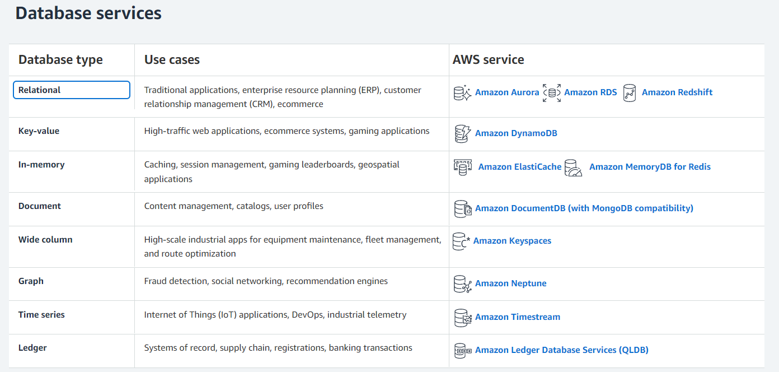
AWS database services

Slide 12
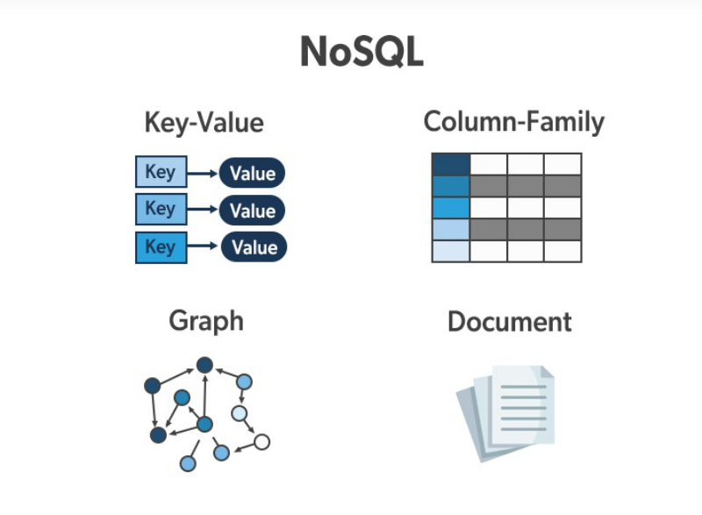
Types of NoSQL
The concept of NoSQL databases became popular with Internet giants like Google, Facebook, Amazon, etc. who deal with huge volumes of data.
The system response time becomes slow when you use RDBMS for massive volumes of data.
NoSQL is a non-relational database that is used to store the data in the nontabular form.
NoSQL stands for Not only SQL.
Types of NoSQL Database:
Document-based databases
Key-value stores
Column-oriented databases
Graph-based databases

Slide 13
Document-based databases
The document-based database is a nonrelational database. Instead of storing the data in rows and columns (tables), it uses the documents to store the data in the database.
A document database stores data in JSON, BSON, or XML documents.
Documents can be stored and retrieved in a form that is much closer to the data objects used in applications which means less translation is required to use these data in the applications.
In the Document database, the particular elements can be accessed by using the index value that is assigned for faster querying.

Slide 14
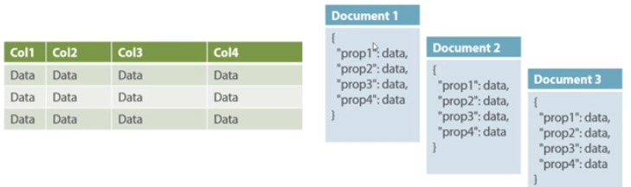
Document-based databases
Key features of documents database:
Flexible schema: Documents in the database has a flexible schema. It means the documents in the database need not be the same schema.
Faster creation and maintenance: the creation of documents is easy and minimal maintenance is required once we create the document.
No foreign keys: There is no dynamic relationship between two documents so documents can be independent of one another. So, there is no requirement for a foreign key in a document database.
Open formats: To build a document we use XML, JSON, and others.

Slide 15
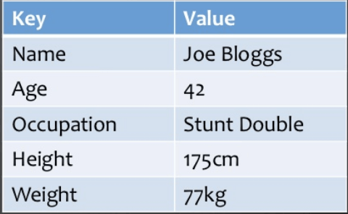
Key-Value Stores
A key-value store is a nonrelational database. The simplest form of a NoSQL database is a key-value store.
Every data element in the database is stored in key-value pairs. The data can be retrieved by using a unique key allotted to each element in the database.
The values can be simple data types like strings and numbers or complex objects.
A key-value store is like a relational database with only two columns which is the key and the value.
Key features of the key-value store:
Simplicity.
Scalability.
Speed.

Slide 16
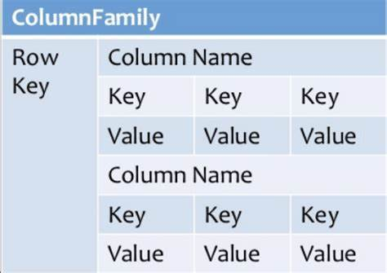
Column Oriented Databases
A column-oriented database is a non-relational database that stores the data in columns instead of rows. That means when we want to run analytics on a small number of columns, you can read those columns directly without consuming memory with the unwanted data.
Columnar databases are designed to read data more efficiently and retrieve the data with greater speed. A columnar database is used to store a large amount of data.
Key features of columnar oriented database:
Scalability.
Compression.
Very responsive.

Slide 17
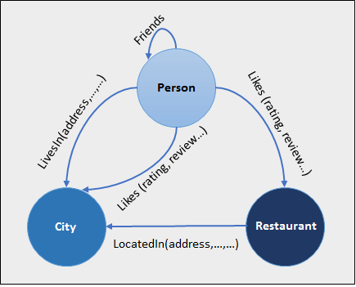
Graph-Based databases
Graph-based databases focus on the relationship between the elements. It stores the data in the form of nodes in the database. The connections between the nodes are called links or relationships.
Key features of graph database:
In a graph-based database, it is easy to identify
the relationship between the data by using the links.
The Query’s output is real-time results.
The speed depends upon the number of
relationships among the database elements.

Slide 18
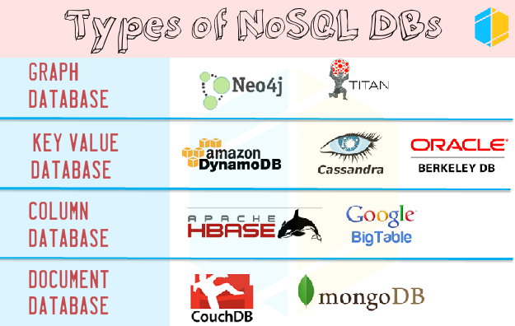

Slide 19
Advantages of No SQL
Can be used as Primary or Analytic Data Source
Big Data Capability
No Single Point of Failure
Easy Replication
No Need for Separate Caching Layer
It provides fast performance and horizontal scalability.
Can handle structured, semi-structured, and unstructured data with equal effect
Object-oriented programming which is easy to use and flexible
NoSQL databases don’t need a dedicated high-performance server
Support Key Developer Languages and Platforms
Simple to implement than using RDBMS
It can serve as the primary data source for online applications.
Handles big data which manages data velocity, variety, volume, and complexity
Excels at distributed database and multi-data center operations
Eliminates the need for a specific caching layer to store data
Offers a flexible schema design which can easily be altered without downtime or service disruption

Slide 20
Disadvantages of NoSQL
No standardization rules
Limited query capabilities
RDBMS databases and tools are comparatively mature
It does not offer any traditional database capabilities, like consistency when multiple transactions are performed simultaneously.
When the volume of data increases it is difficult to maintain unique values as keys become difficult
Doesn’t work as well with relational data
The learning curve is stiff for new developers
Open source options so not so popular for enterprises.

Slide 21
Design Features

Slide 22
Design features
Data replication
Conflict resolution
Scalability
Symmetry
Flexibility

Slide 23
Data replication
To achieve high availability and reliability.
Traditional data replication techniques - synchronous replica update
to avoid wrong or stale data being provided to the user.
not that efficient, as networks and disks are bound to fail and waiting for all data replicas to get updates was really time consuming.

Slide 24
Data replication
Eventual consistency - replicas would be updated asynchronously by a background process.
solved the problem of availability but leads to conflicts.
If a node gets updated with a new attribute value, an asynchronous process will start updating the replicas in the background.
Suppose, that one of the nodes where a replica for the same data resides is not available for update, then that node would have the same old value. Meanwhile, if the node becomes available again and gets a read request, then it would present the old value, and there would be a conflict between this node and other nodes.

Slide 25
Conflict resolution
When to resolve the conflict?
Who would be resolving the conflict?

Slide 26
Conflict resolution- When to resolve ?
Conflicts can be resolved at read time or write time.
Most data store systems resolve conflicts on write operations ==> keep the read operation fast and lightweight.
But DynamoDB always use writable strategy, allowing writes all the time.
Amazon's business point of view ==>people need not to wait for some write to happen until the conflict is resolved.
User be able to add items to the cart at all times.
If it does not happen, then it would give a bad user experience and would lead to a serious impact on Amazon's business.

Slide 27
Conflict resolution- Who will resolve ?
It is also equally important to decide who would resolve the conflict, that is, the application or the database.
When it comes to the database resolving conflicts, it prefers to use the last write wins strategy.
In the case of Amazon, you are given the choice to choose your own conflict resolution by providing features such as conditional writes

Slide 28
Scalability
System should be scaled out easily without affecting the application.
DynamoDB uses the ring topology to arrange its nodes.
So, whenever there is a need to scale up the cluster, you can easily add a node to the existing cluster without affecting system performance.
As a DynamoDB service user, we don't have access to scale up or scale down clusters; what we can do for this is to increase or decrease the provisioned throughput.

Slide 29
Symmetry
DynamoDB targets symmetry in its node cluster, which means that no node is the master node, neither do they perform extra work or have extra responsibility than others.
Helps in maintaining the system properly balanced
No need to worry about failures, as even if a node or two fails, the system would remain intact.
There is no single point of failure in DynamoDB

Slide 30
Flexibility
DynamoDB's ring architecture allows nodes of different configurations to be a part of the same cluster
Each node gets the amount of responsibility it deserves.
Flexibility to add nodes as and when they are required and of whatever size and configurations they are, they would be loaded with work.

Slide 31
Service Oriented Architecture

Slide 32
DynamoDB Architecture
DynamoDB's architecture consists of various well-known, and a few new, techniques that have helped engineers build such a great system.
To build a robust system like this, one has to consider various things, such as load balancing, partitioning, failure detection/ prevention/ recovery, replica management and their sync, and so on.

Slide 33
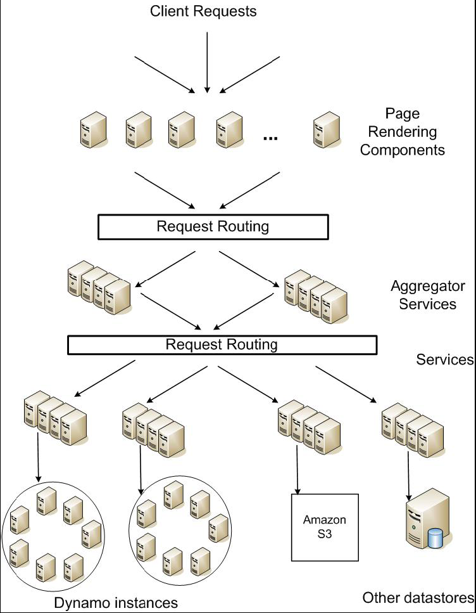
Service Oriented architecture of DynamoDB

Slide 34
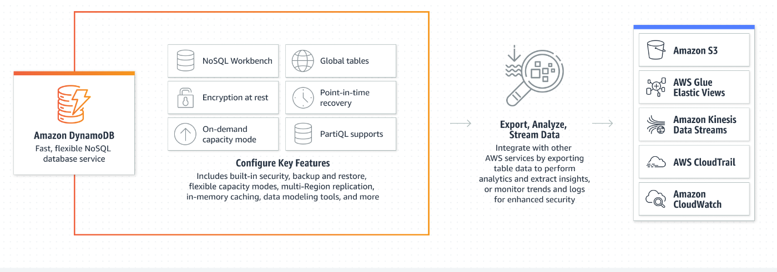
Core features of Amazon DynamoDB and integrations with other AWS services.

Slide 35

NoSQL Workbench
NoSQL Workbench is a visual tool that provides data modeling, data visualization, and query development features to design, create, query, and manage DynamoDB tables.
Can design and create data schemas from scratch or by using of one of several sample data model templates, complete with datasets
Benefits
One tool for design, development, and deployment
Easy to get started
Generate sample code in multiple languages

Slide 36
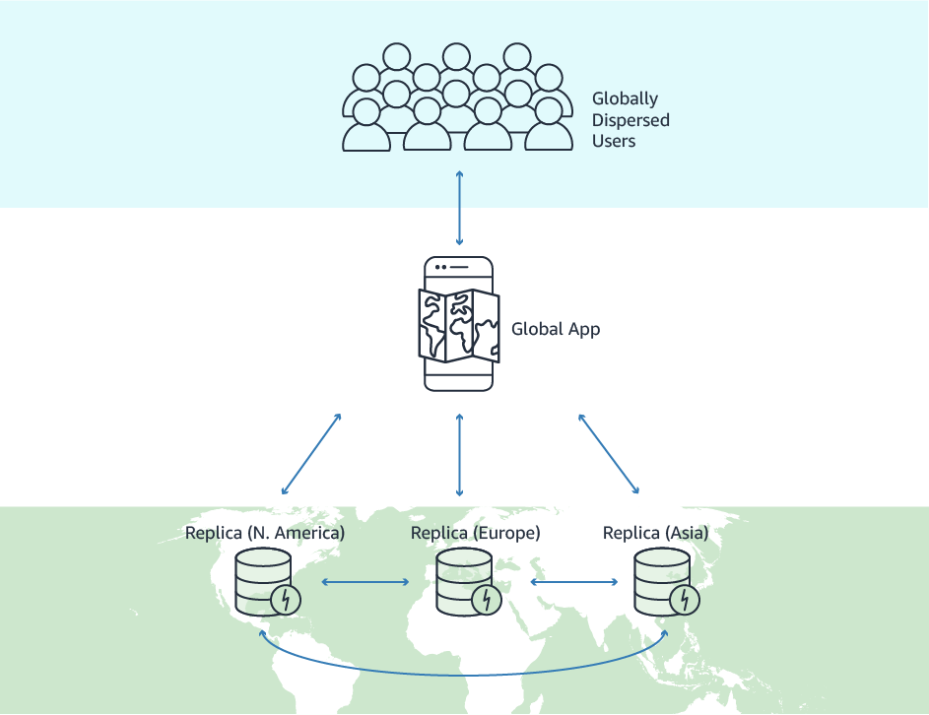
Global table
Global table is the collection of one or more replica tables, all belonging to a single AWS account.
Replica table (or just replica) is a single DynamoDB table that works as part of a global table. Each replica stores the same set of data items. Any given global table can only have one replica table per AWS region.

Slide 37
Global table
Global table is the collection of one or more replica tables, all belonging to a single AWS account.
Replica table (or just replica) is a single DynamoDB table that works as part of a global table. Each replica stores the same set of data items. Any given global table can only have one replica table per AWS region.

Slide 38
Benefits of Global Table
Replicating your DynamoDB tables automatically across your choice of AWS Regions
Eliminating the difficult work of replicating data between Regions and resolving update conflicts, so you can focus on your application's business logic.
Helping your applications stay highly available even in the unlikely event of isolation or degradation of an entire Region.

Slide 39
Point In Time Recovery
back up your table data continuously by using point-in-time recovery (PITR).
DynamoDB backs up your table data automatically with per-second granularity so that it can be restored to any given second in the preceding 35 days.

Slide 40
PartiQL
PartiQL provides SQL-compatible query access across multiple data stores containing structured data, semistructured data, and nested data.
Using PartiQL, one can easily interact with DynamoDB tables and run ad hoc queries using the AWS Management Console, NoSQL Workbench, AWS Command Line Interface, and DynamoDB APIs for PartiQL.

Slide 41
On demand capacity mode
DynamoDB charges you for the data reads and writes your application performs on your tables.
User do not need to specify how much read and write throughput of the application
DynamoDB instantly accommodates your workloads as they ramp up or down.

Slide 42
Encryption at rest
Encryption at rest is encryption that is used to help protect data that is stored on a disk (including solid-state drives) or backup media.
Provides an additional layer of data protection by always securing your data in an encrypted table—including its primary key, local and global secondary indexes, streams, global tables, backups, and DynamoDB Accelerator (DAX) clusters whenever the data is stored in durable media.

Slide 43
Load balancing
Consistent hashing dynamically partitions the data over the network and keeps the system balanced.
To find a node in a distributed cluster to store and retrieve a value identified by a key, while at the same time being able to handle the node failures.
both the nodes and the keys are hashed and the same technique is used for their lookup.
Create a hash space or hash ring
Determining a hash value for each node in a cluster - placing that node on the circumference of the hash ring
Node failure, the load managed by this node gets evenly distributed among the other nodes from the cluster,

Slide 44
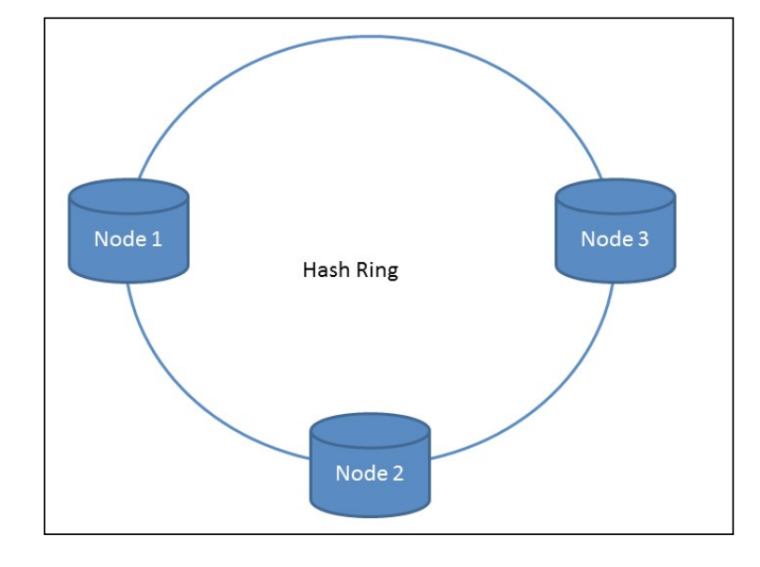
Load balancing

Slide 45
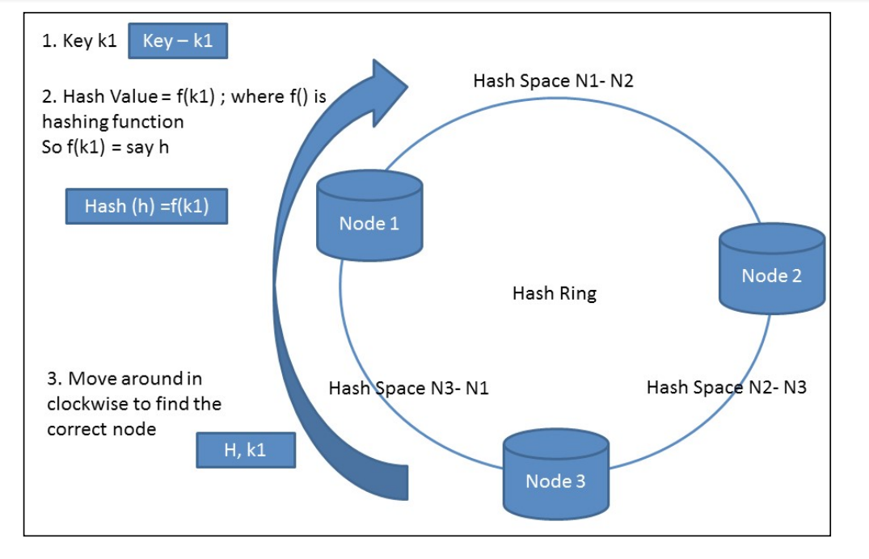
Load balancing

Slide 46
Issues in consistent hashing
uneven distribution of load as, if a key is not able to find a position, it will always go to the first node
Increase the difference in the performance of various nodes impacting the overall system
DynamoDB uses a variant of consistent hashing - it assigns a node to multiple points on the hash ring circle - which would represent a single physical machine.
Doing so helps in making distribution of data even across the cluster.

Slide 47
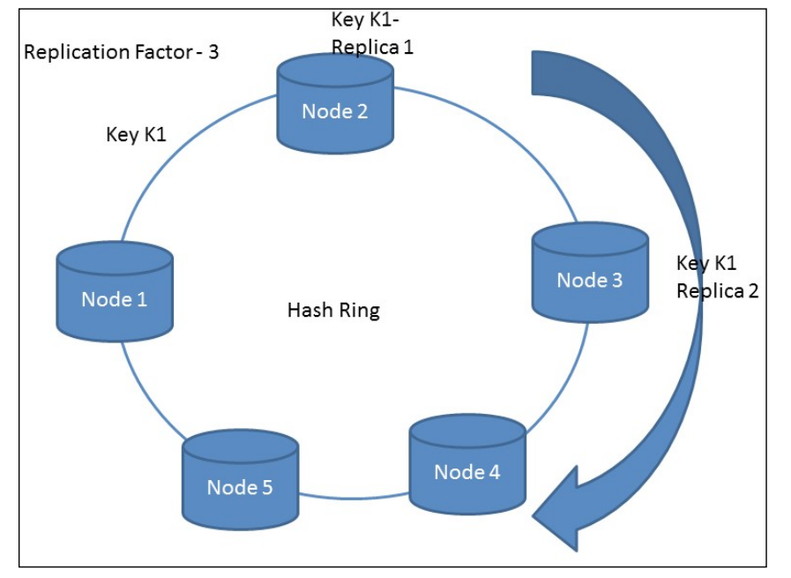
Data replication
Data replication -- special type of node -- coordinator node.
The replication factor (N) is configured per instance -- number of replications of a certain key.
The coordinator node first keeps the key on the local machine and then replicates it to N minus 1 successor machine in the clockwise direction

Slide 48
Data replication
if a key K1, falls in the range Node1-Node2, then replicas of the key would be stored on two successor nodes of Nodel.
Preference list - The list of nodes saving a particular key

Slide 49
Data versioning & reconciliation
Data versioning in DynamoDB is a simple yet helpful concept.
A new attribute to save the version when versioning is enabled.
DynamoDB will assign a version for when you first save a tuple, and it will increment the versions as you update the tuple.
When updating into a new version, the versioning concept is to create an entirely new item that uses the same partition key (which was in the previous version) and a different sort key.

Slide 50
Data versioning & reconciliation
DynamoDB uses vector clocks to do the object versions and their conflict resolution.
A vector clock is a mechanism that helps in maintaining various versions of an object and in resolving the conflicts
Two types of reconciliation
Logic-based reconciliation
Time-based reconciliation

Slide 51
Types of reconciliation
Logic-based reconciliation
the client who has requested the data object itself decides whether it has got the exact version of the data object it was looking for.
(eg) Amazon's shopping cart service; here, in the event of any conflict, the business logic itself reconciles the object and solves the conflict.
Time-based reconciliation
simplest algorithm used for reconciliation of different versions
object version with the latest timestamp is supposed to be updated and used to return to the client.
need to make sure that the systems that have the replicas have their calendars in sync.

Slide 52
Request Handling
Two strategies to select a node:
Route its request through a generic load balancer that will select a node based on load information.
Use a partition-aware client library that routes requests directly to the appropriate coordinator (first) nodes.

Slide 53
Handling failures
Reasons for failures in a distributed system --
such as node failures, disk failures, network issues, power failures, or even natural or unnatural disasters.
Data loss at any given cost is simply not acceptable.
Temporary failures - Hinted Handoff
Permanent failures - Merkle Trees

Slide 54
Hinted Handoff
DynamoDB would experience reduced durability and availability if the traditional form of quorum approach is used.
To overcome this -- sloppy quorum; all READ and WRITE operations are performed on the first N healthy nodes from the preference list, which may not be the first N nodes encountered by traversing the consistent hashing ring.

Slide 55
Hinted Handoff
If A is temporarily not reachable during a WRITE operation, then the replica that would have lived on A will be sent to D to maintain the desired availability and durability guarantees.
The replica sent to D will have a hint in its metadata which tells who the intended recipient was.
The hinted replicas are stored in a separate local database which is scanned periodically to detect if A has recovered. Upon detection, D will send the replica to A and may delete the object from its local store without decreasing the total number of replicas. Using hinted handoff, DynamoDB ensures that READ and WRITE are successful even during temporary node or network failures.

Slide 56
Merkle Tree
DynamoDB - maintain the replica synchronization.
Comparing all existing replicas and updating replicas with the latest changes is called AntiEntropy.
A Merkle tree is an algorithm used to store and compare objects.
In a Merkle tree, the root node contains the hash of all children, and if the hash values of the root nodes of two trees are the same, then it means those two trees are equal.

Slide 57
Ring membership
Administrator to initiate a membership change request and inform any one member in the DynamoDB cluster.
Node addition or deletion -- a command line and browser tool
history is maintained to keep track of all membership change requests.
Gossip-based protocol to propagate the changes made to its membership.

Slide 58
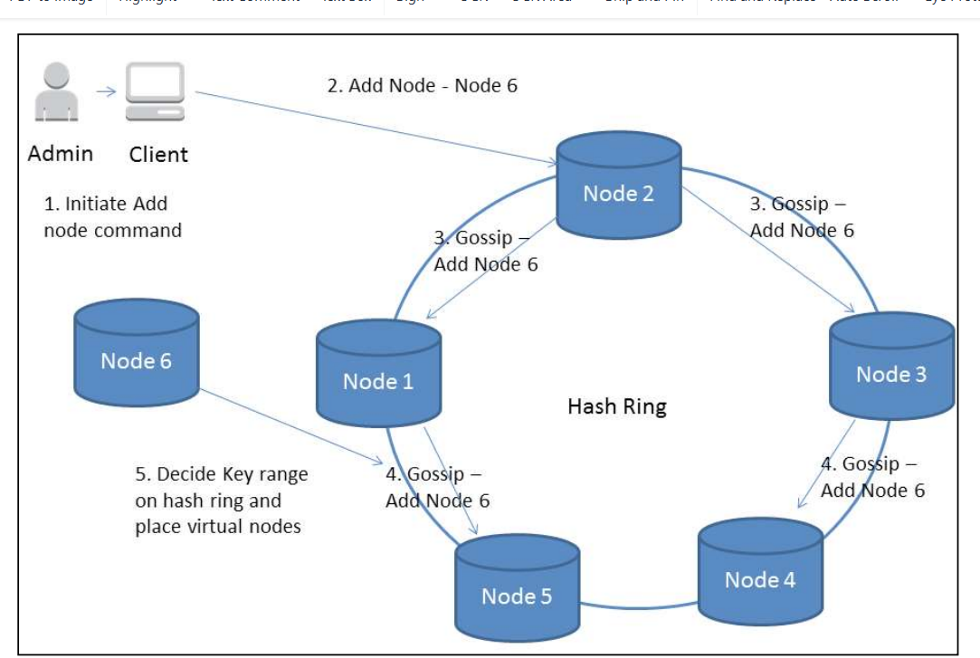
Membership change

Slide 59
Seed Nodes
Seed nodes - have static information about the cluster.
have all the information about the membership, as the information is derived from an external service.
All nodes ultimately reconcile the membership information with seed nodes.

Slide 60
Functional Components

Slide 61
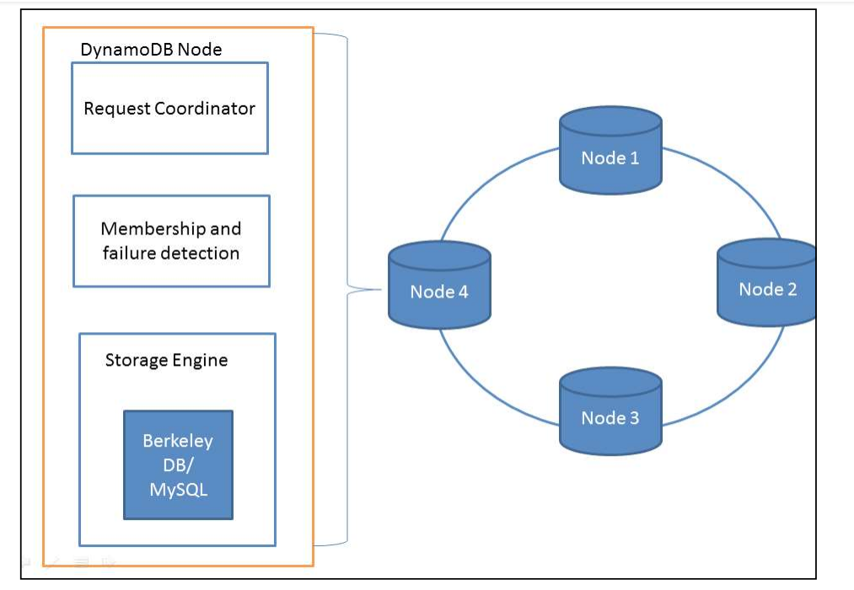
Functional Components
Each DynamoDB node consists of the following components:
Request coordinator
Membership and failure detection
Local persistent store (storage engine)

Slide 62
Request Coordinator
The request coordinator is an event-driven messaging component that works like Staged-Even Drive Architecture (SEDA). Here, we break the complex event into multiple stages.
decouples event and thread scheduling from application logic.
responsible for handling any client requests corning its way.

Slide 63
Membership failure and detection
responsible for maintaining the membership information of the node for a certain cluster.
also keeps track of any new node addition or removal and manages the key range accordingly.
All membership-related information, such as key hash ranges of peers and seed nodes, is maintained by this service.
This is a very crucial component from the distributed system coordination point of view.

Slide 64
Local persistence store
A pluggable system where one can select the storage depending upon the application use.
uses Berkeley DB or MySQL as the local persistence store.
Berkeley DB is a high-performance embedded database library used for key-value pair type of storage (object size has a maximum limit of 10 KB)
MySQL is used for application object size expected to be on the higher side.

Slide 65
Berkeley DB has three products under one umbrella:
Berkeley DB, which is a traditional library written in C
Berkeley DB Java Edition, which supports important Java features, such as POJOs, Collections, and so on
Berkeley DB XML edition, which supports data storage of XML documents

Slide 66
Summary of techniques used in DynamoDB and their advantages
Problem | Technique | Advantage
Partitioning | Consistent Hashing | Incremental Scalability
High Availability for writes | Vector clocks with reconciliation during reads | Version size is decoupled from update rates.
Handling temporary failures | Sloppy Quorum and hinted handoff | Provides high availability and durability guarantee when some of the replicas are not available.
Recovering from permanent failures | Anti-entropy using Merkle trees | Synchronizes divergent replicas in the background.
Membership and failure detection | Gossip-based membership protocol and failure detection. | Preserves symmetry and avoids having a centralized registry for storing membership and node liveness information.

